Slide 1
T1A3 Portfolio Website
The making, walk-through and it’s features…

Slide 2

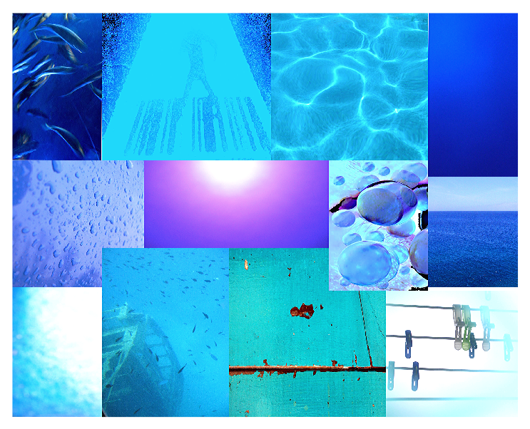
MoodBoard

Slide 3
Site Map

Slide 4
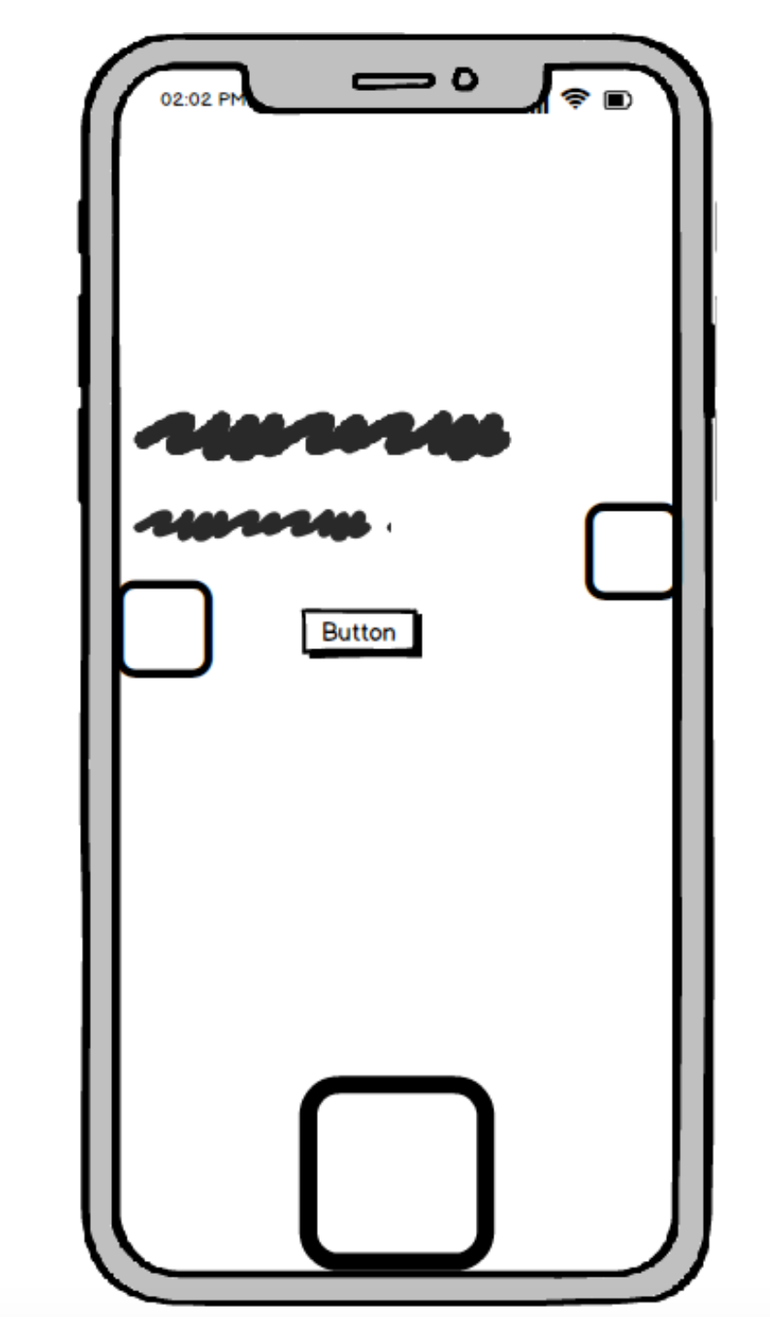
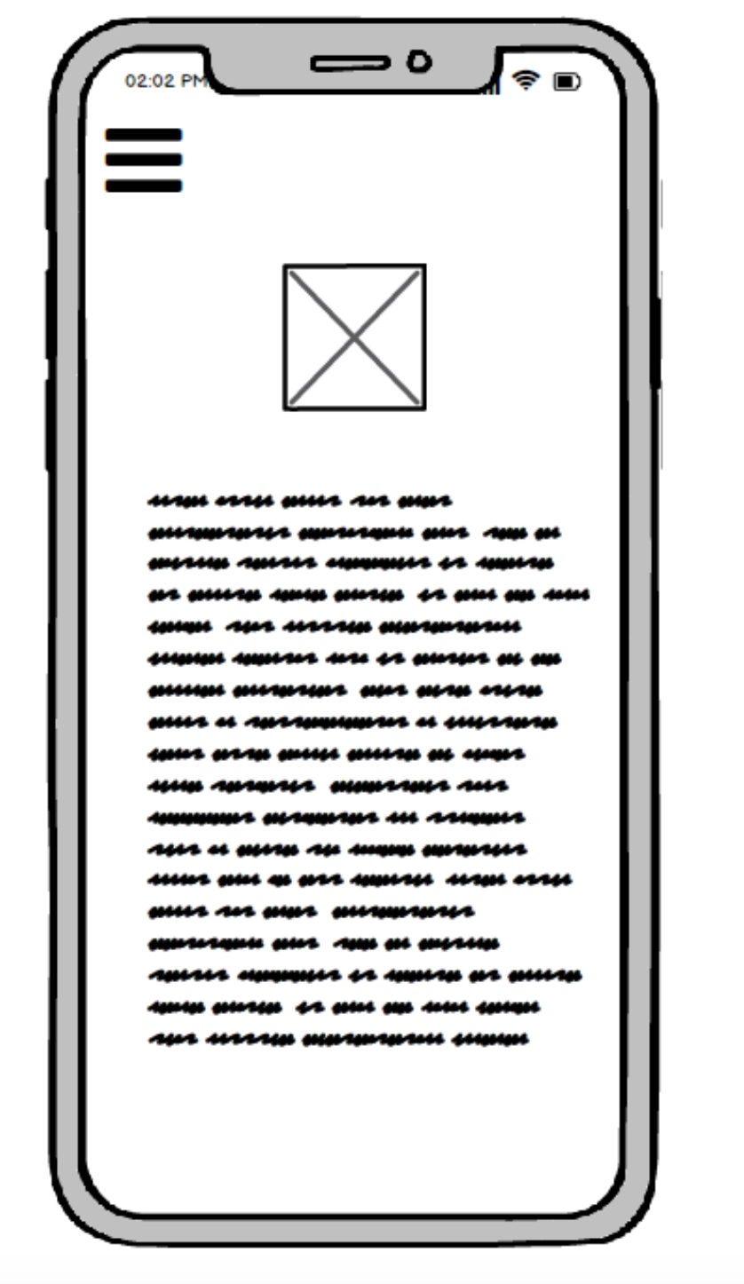
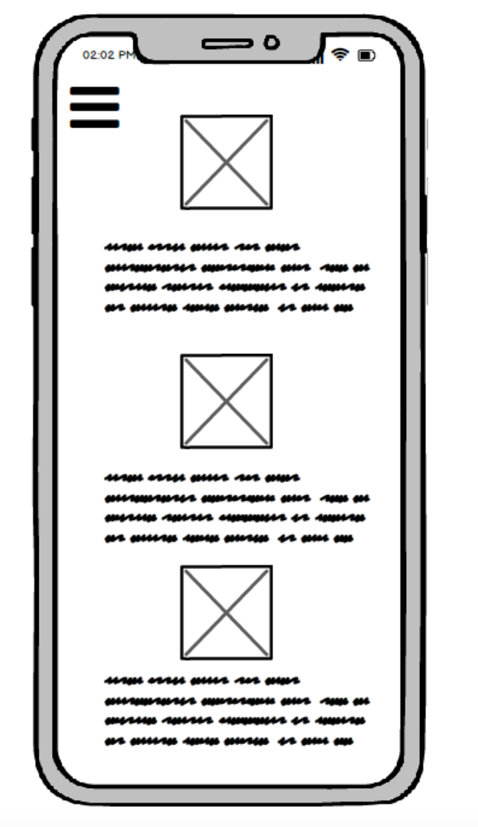
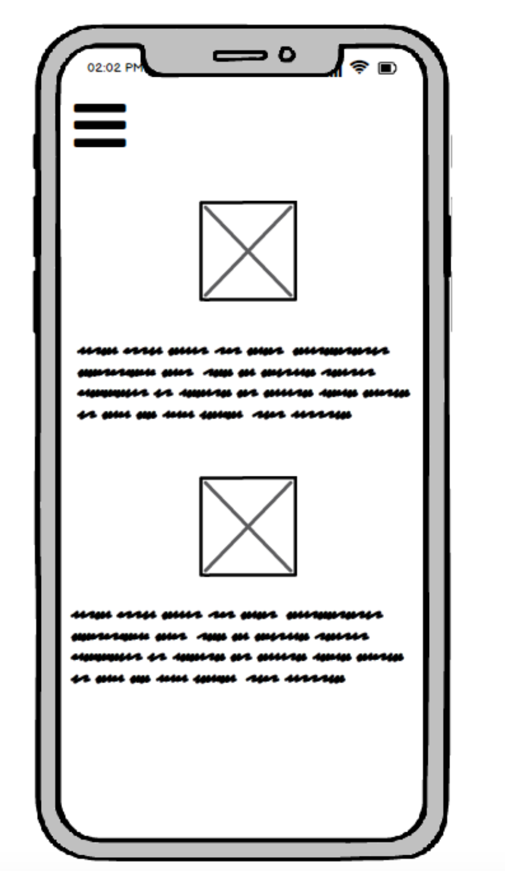
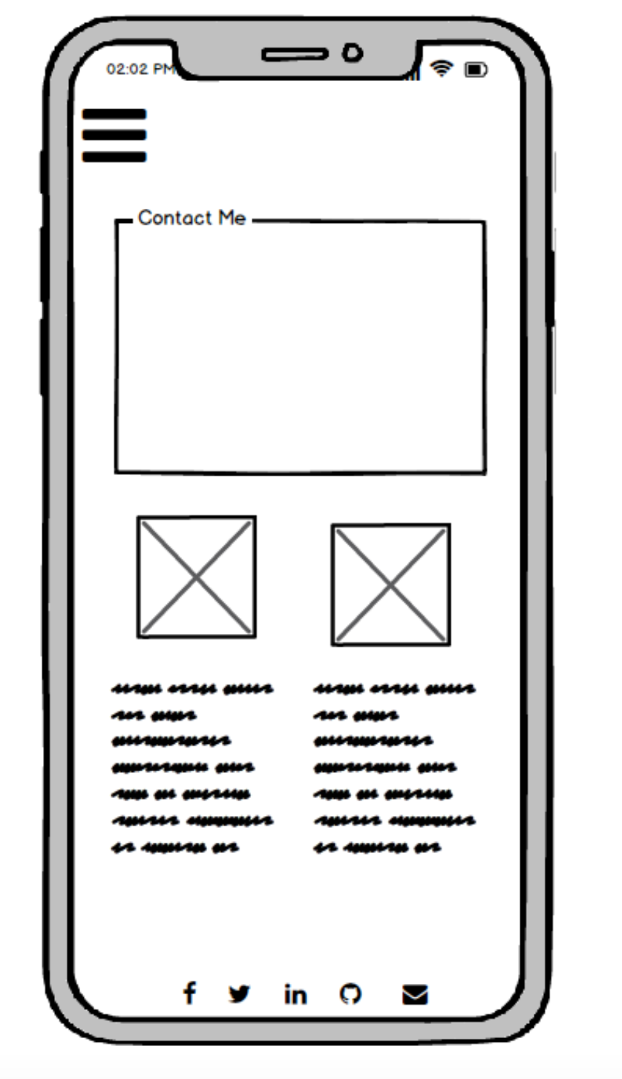
Wireframes
Mobile Version

Slide 5
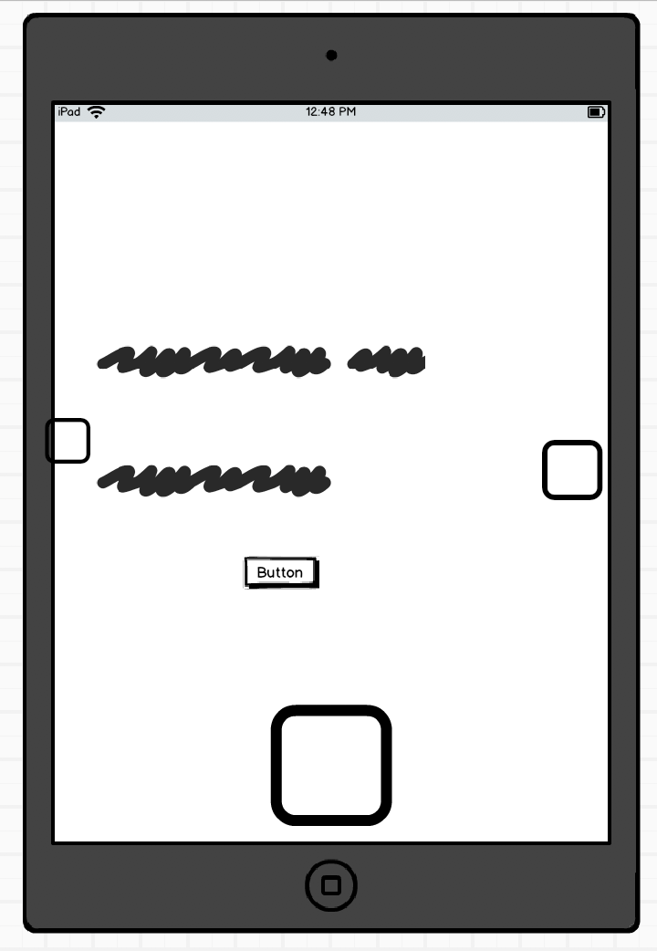
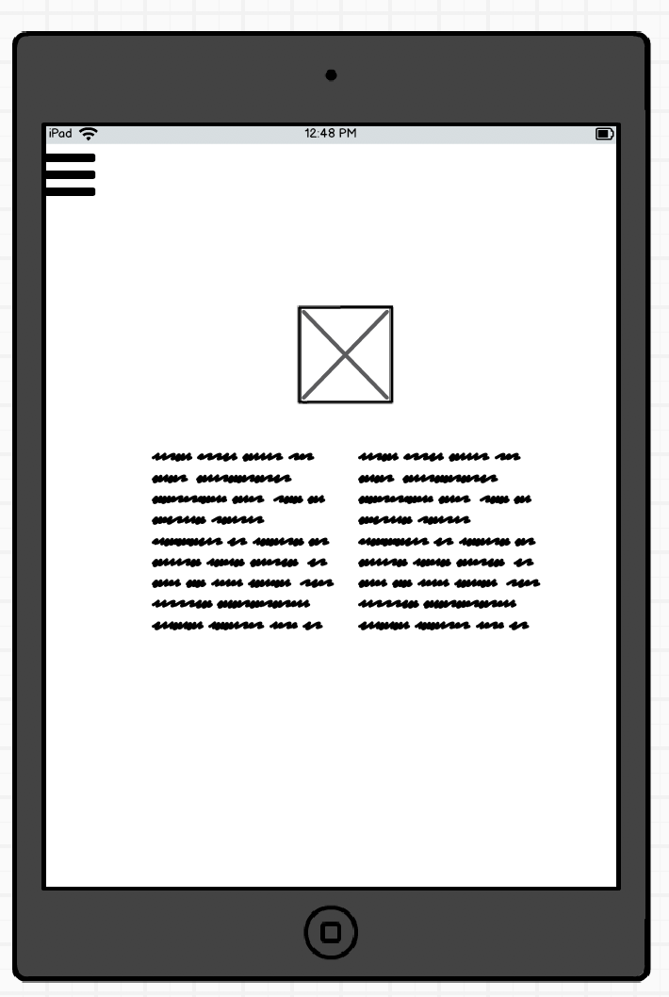
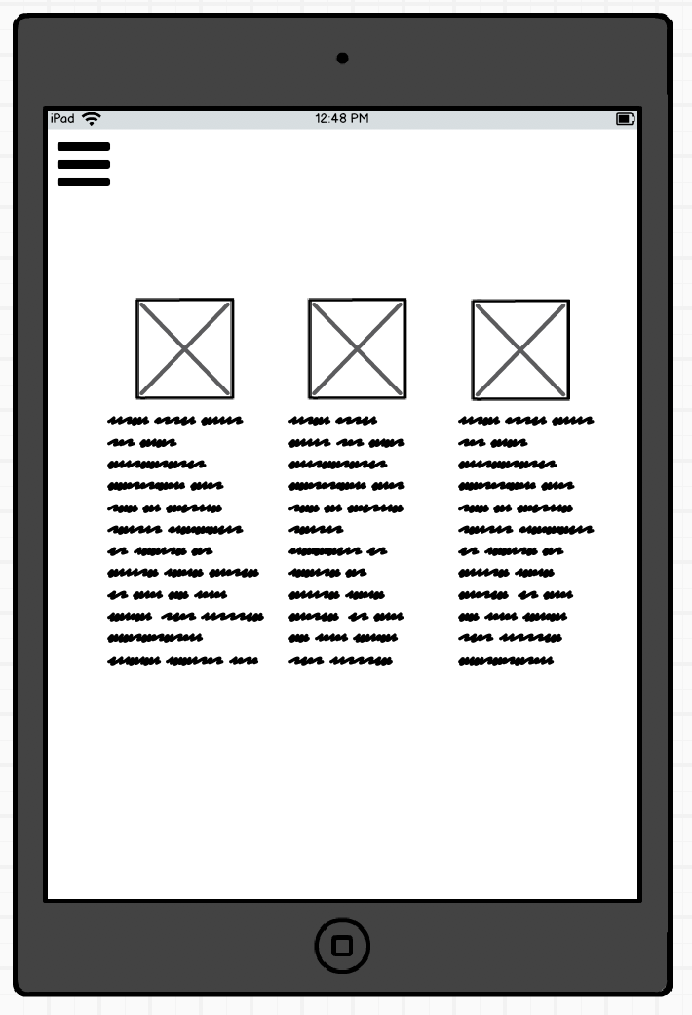
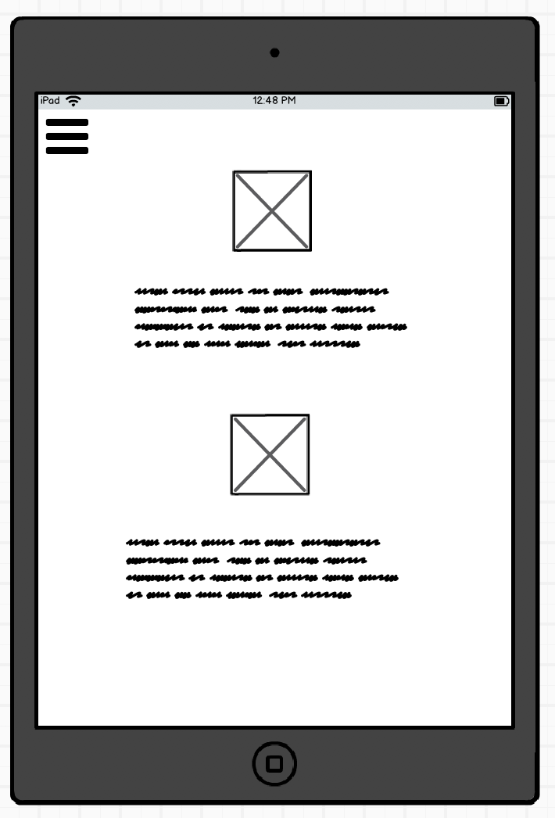
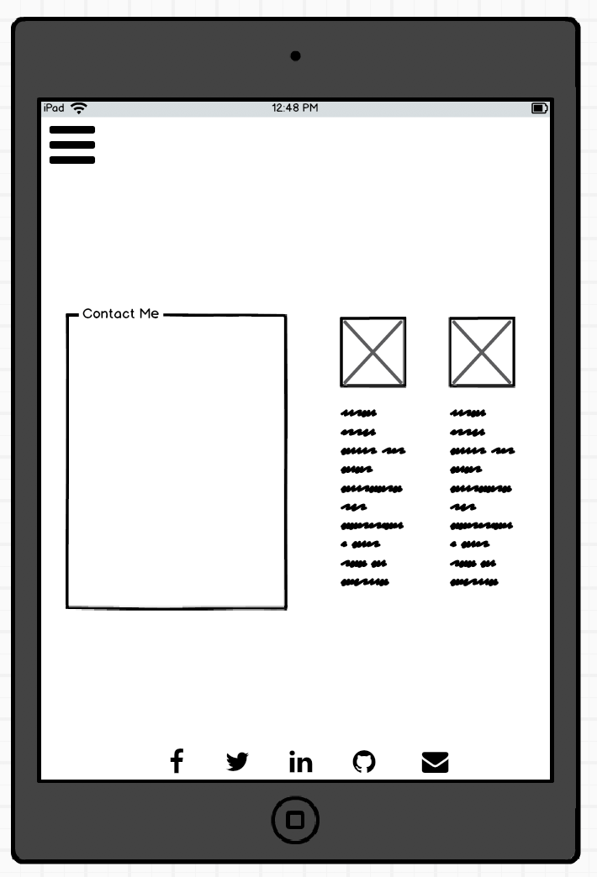
Wireframes
Tablet Version

Slide 6
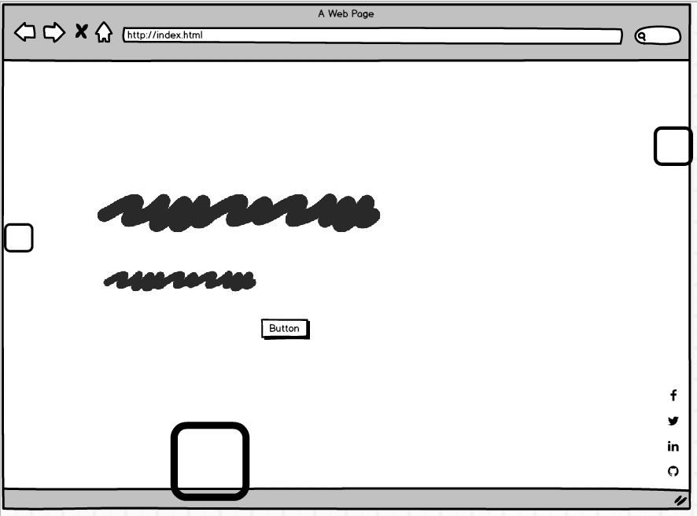
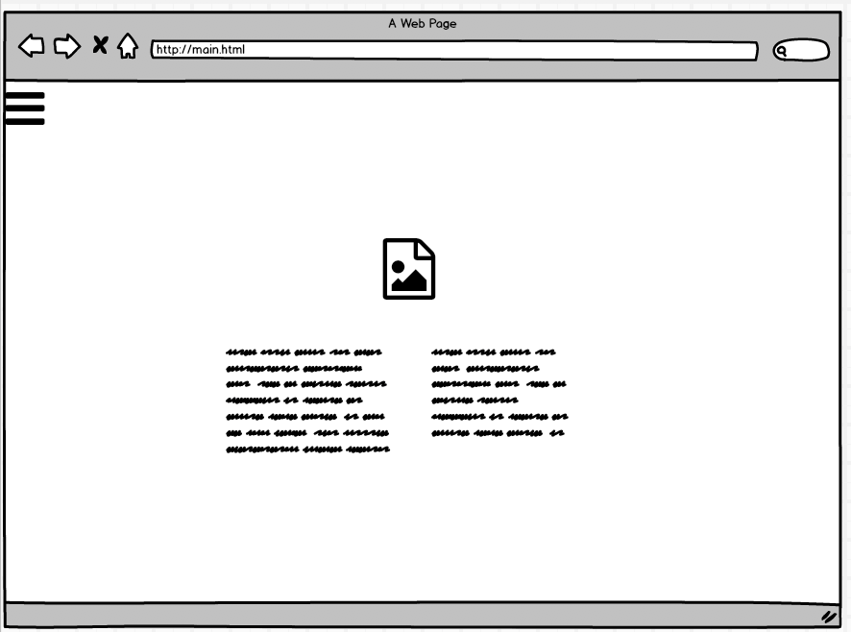
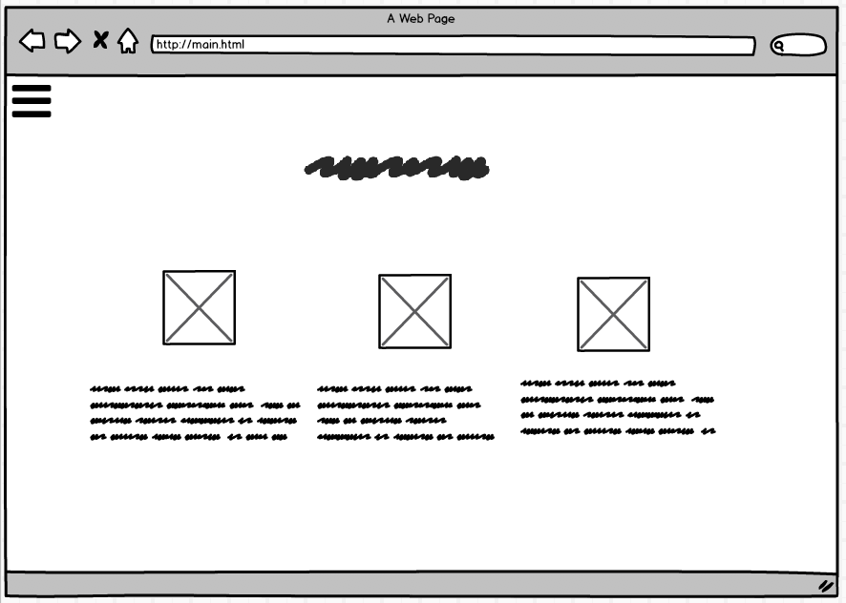
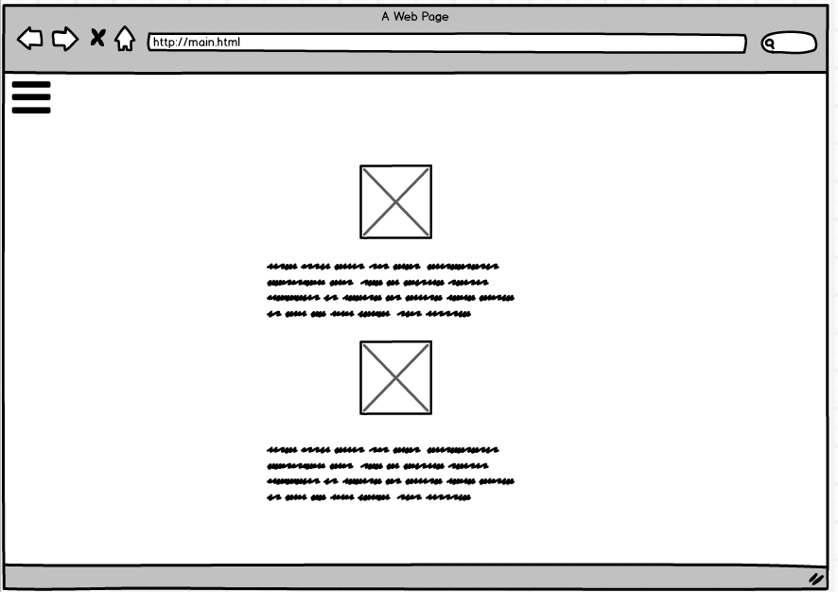
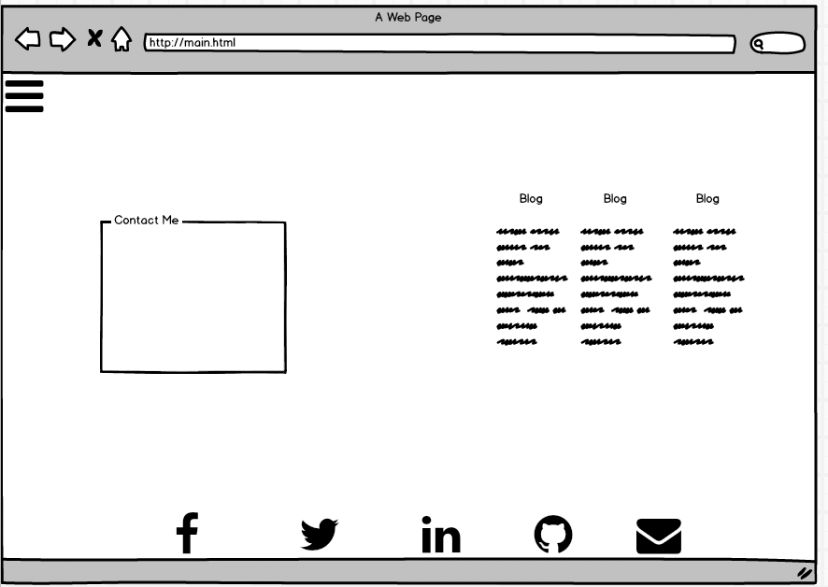
Wireframes
Desktop Version

Slide 7

HOMEPAGE
DIV
DIV
DIV
HTML5
FONTAWESOME (ICONS)
SECTION/DIV/UL/LI/H2/H3
CSS
Animation and Keyframes
Transform ScaleX & Y
Transform Translate Y
Transform Rotate
A
DIV
UL

Slide 8
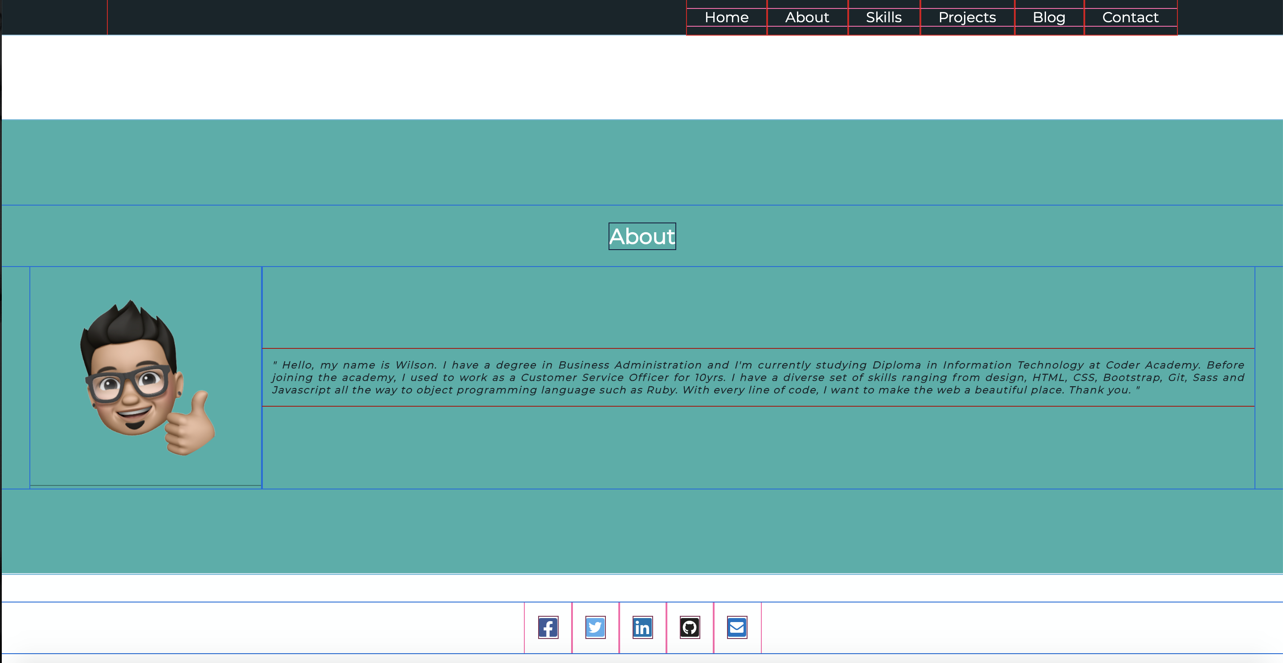
About Page
{Header}
{UL / LI}
HTML
Header/Footer
FontAwesome
Div/H1/Img/UL&Li
CSS
Flex
Transform Rotate and Scale
Media Query
DIV
H1
DIV
DIV
IMG
P
Font Awesome
{Footer}

Slide 9
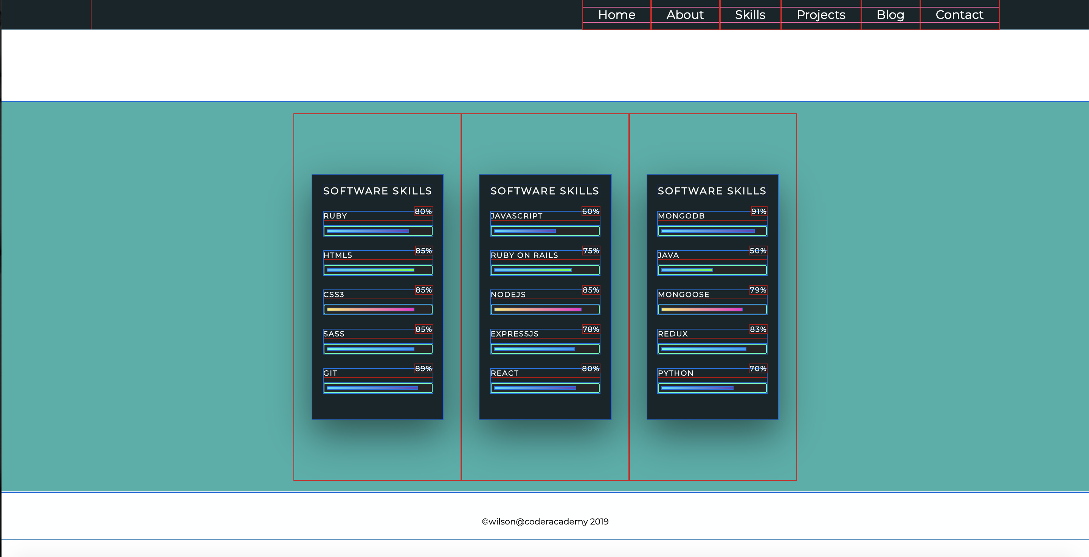
Skills Page
HTML
Header/Footer
DIV/H1/P/UL & LI
CSS
Flex
Animation :Width
Linear Gradient
Media Query
header
UL/LI
DIV
DIV
DIV
DIV
DIV
DIV
DIV
DIV
footer

Slide 10
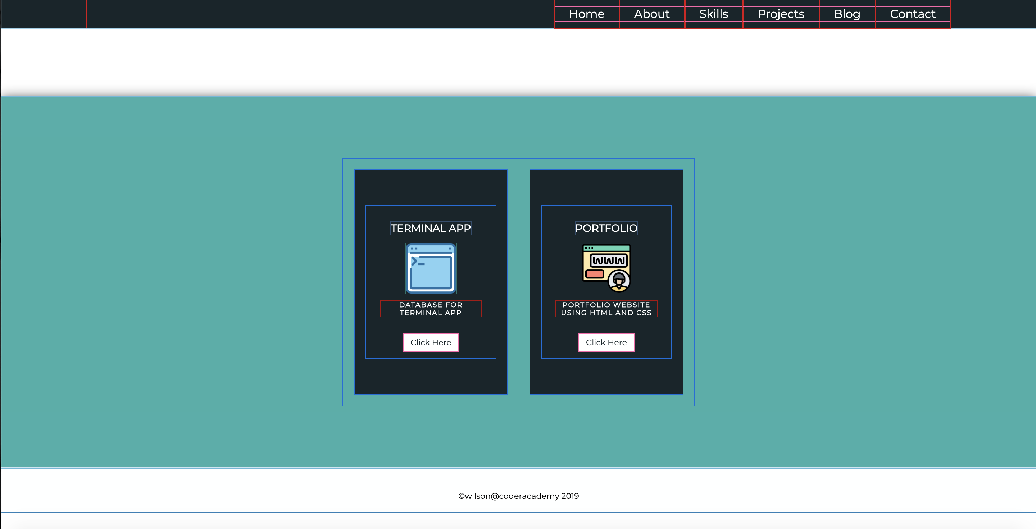
Project Page
header
UL/LI
DIV
HTML
Header/Footer
div/h2/img/p/a/ul&li
CSS
Flex
Filter:Blur
Transform:ScaleY
Media Query
DIV
DIV
DIV
DIV
DIV
h2
img
p
a

Slide 11
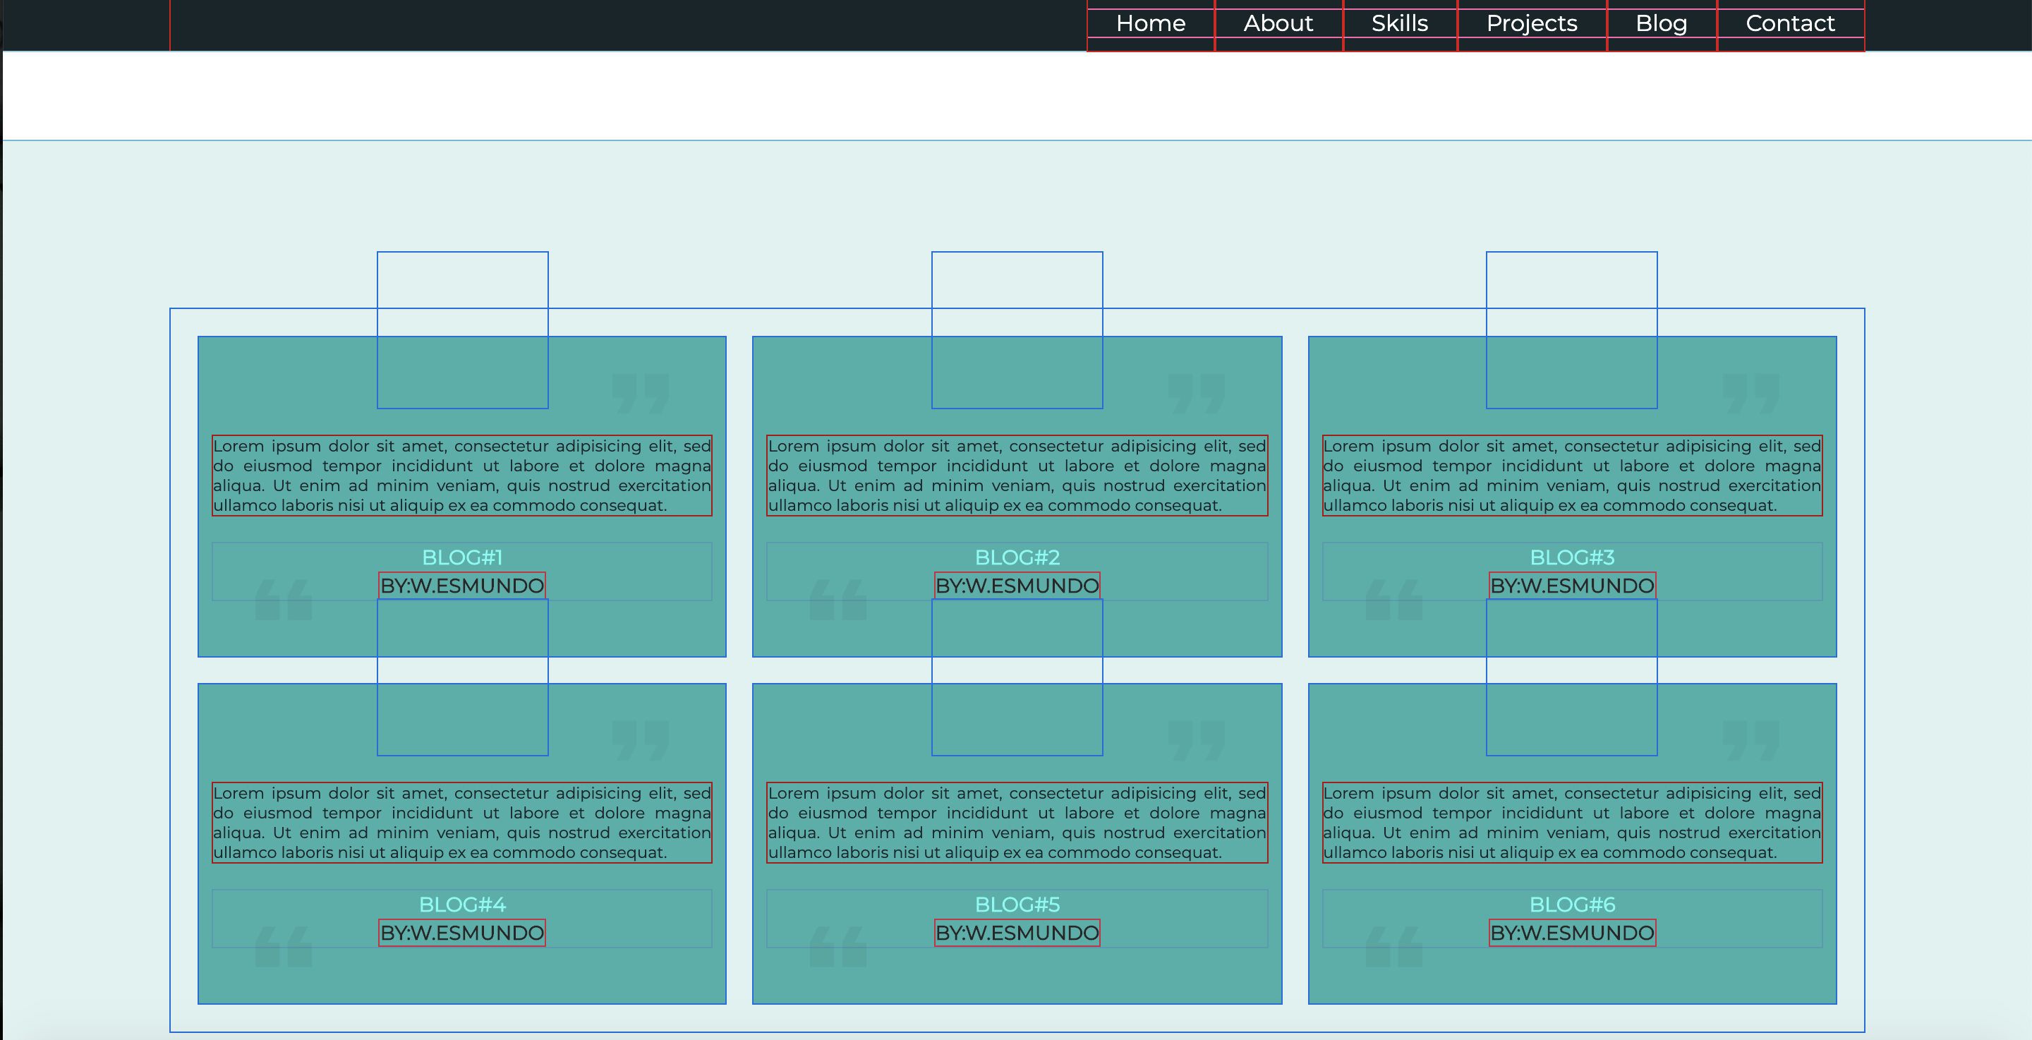
Blog Page
Header
UL/LI
DIV
HTML
Header/Footer
div/img/ul & li
CSS
Flex
Grid
Transform: rotate
Transform:translate
Transform:scale
img
img
img
DIV
DIV
DIV
img
img
img
DIV
DIV
DIV

Slide 12
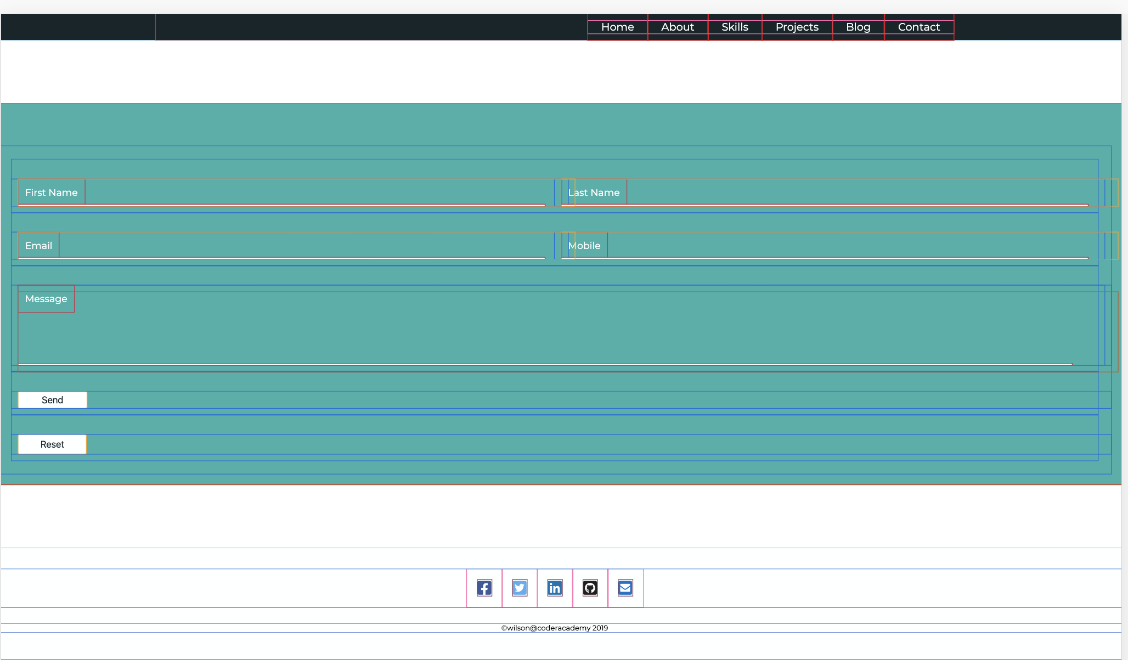
Contact Page
HTML
Header/Footer
FontAwesome(icons)
Form (inputs)
Divs/a/ul&li
Script
CSS
Flex
Grid

Slide 13
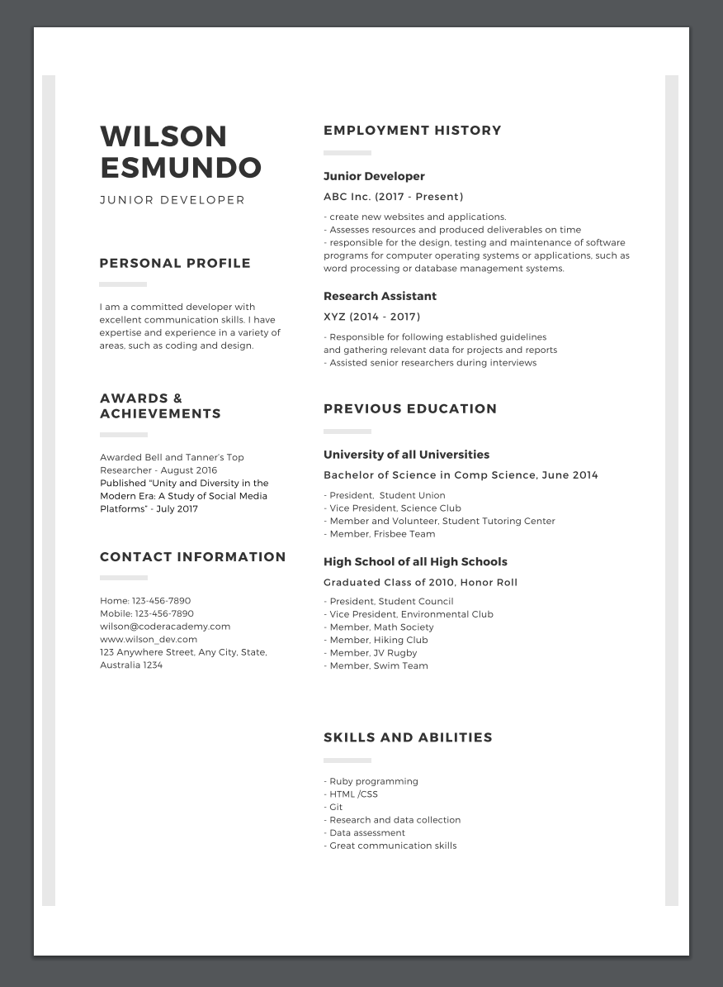
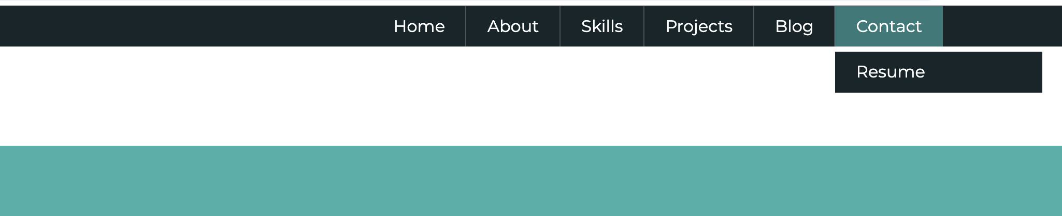
Resume download
Anchor tag

Slide 14

Any Questions?

